Slide 1
Chemical Reactions and Equations
CHAPTER 1
PART 2- TYPES OF CHEMICAL REACTION
Notes:
Lets start with our Chapter 1- that is Chemical Reactions and Equations

Slide 2
TYPES OF CHEMICAL REACTION
Types of reactions
Combination Reaction
Decomposition Reaction
Displacement Reaction
Double Displacement Reaction
Notes:
Till now we saw what a chemical reaction is , what are reactants what are products , lets now see what are the different types of reactions possible :
There are 4 types of reaction-Combination Reaction ,Decomposition Reaction ,Displacement Reaction and Double Displacement Reaction.

Slide 3
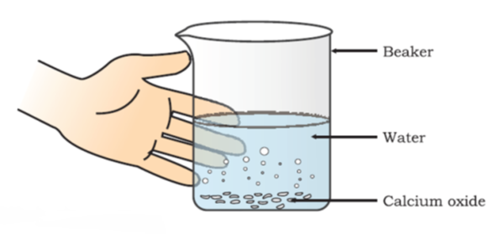
COMBINATION REACTION
A reaction in which a single product is formed from two or more reactants is known as a combination reaction.
Formation of slaked lime by the reaction of calcium oxide with water
Notes:
Lets start with our first type of reaction combination reaction , as the name suggests it is combination that means we are trying to add two or more things to make one.
Lets understand this more with an experiment Take calcium oxide or quick lime in a beaker and add water to it . Now touch the beaker .Do you observe a change in it ?
Now we ll see the reaction for it

Slide 4
REACTIONS HAPPENING IN THE EXPERIMENT
Calcium oxide reacts vigorously with water to produce slaked lime (calcium hydroxide) releasing a large amount of heat.
(Quick lime) (Slaked lime)
A solution of slaked lime produced by the reaction is used for whitewashing walls. Calcium hydroxide reacts slowly with the carbon dioxide in air to form a thin layer of calcium carbonate on the walls.
(Calcium hydroxide) (Calcium Carbonate)
CaO(s)
+
Heat
+
H2O
Ca(OH)(aq)
Ca(OH)2(aq
+
CO2
CaCO3
+
H2O(l)
Notes:
With the mixture calcium hydroxide or slaked lime is produced and heat is released .This slaked lime can be used for whitewashing ,what happens is this calcium hydroxide reacts with the carbon di oxide in the atmosphere and produces a thin layer of calcium carbonate on the walls.

Slide 5
SOME MORE EXAMPLES OF COMBINATION REACTION:
Burning of coal
Formation of water from H₂(g) and O₂(g)
C(s)
+
O2(g)
Co2(g)
2H2(g)
+
O2
2H2O(l)
Notes:
These are some more examples of chemical reaction :
Burning of coal or formation of water

Slide 6
EXOTHERMIC REACTION
Reactions in which heat is released along with the formation of products.
Example:
Burning of natural gas
Do you know that respiration is an exothermic process?
CH2(g)
+
2O2(g)
CO2(g)
+
2H2O(g)
C6H12O6(aq)
+
6O2(aq)
6CO2(aq)
+
6H2O(l)
+
Energy
Notes:
As we saw in our above experiment heat was released along with the formation of product ,such reactions are called exothermic reaction.

Slide 7
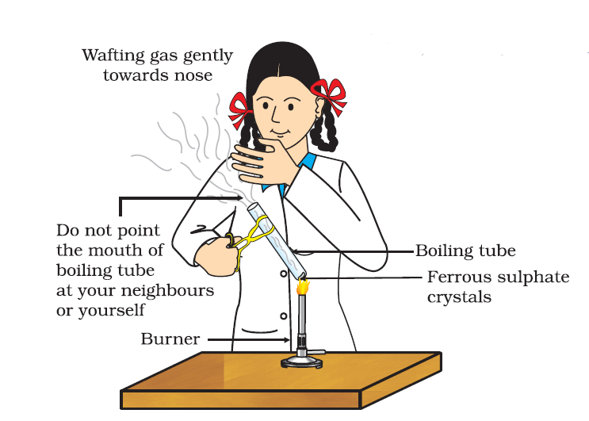
DECOMPOSITION REACTION
Those reactions in which a compound splits up into two or more simpler substances are known as decomposition reactions.
Correct way of heating the boiling tube containing crystals of ferrous sulphate and of smelling the odour
Notes:
Next type of chemical reaction we are going to study is called Decomposition Reaction.
So we will take an example for it -Take about 2 g ferrous sulphate crystals in a dry boiling tube. Note the colour of the ferrous sulphate crystals. Now again heat the boiling tube over the flame of a burner or spirit lamp. Lets note the colour again after heating.

Slide 8
REACTIONS HAPPENING IN THE EXPERIMENT
The green colour of the ferrous sulphate crystals changes. We can also smell the characteristic odour of burning sulphur.
2FeSO4(s)
Fe2O3(s)
+
SO2(g)
+
SO3(g)
+
Anhydrous ferrous Ferric Oxide
Sulphate(white) (brown)
Ferrous sulphate crystals contain water molecules (FeSO₄. 7H₂O).
On heating, ferrous sulphate crystals lose water and anhydrous ferrous sulphate (FeSO₄) is formed. So their colour changes from light green to white.
On further heating, ferric oxide (Fe₂O₃), sulphur dioxide (SO₂) and sulphur trioxide (SO₃) are formed. So, the gas emitted smells like burning sulphur.
Notes:
We can see that the green colour of the ferrous sulphate crystals changes. We can also smell the characteristic odour of burning sulphur. Now we see what happens after heating- On heating, ferrous sulphate crystals lose water and anhydrous ferrous sulphate (FeSO₄) is formed. So their colour changes from light green to white.
On further heating we get smell of sulphur burning.

Slide 9
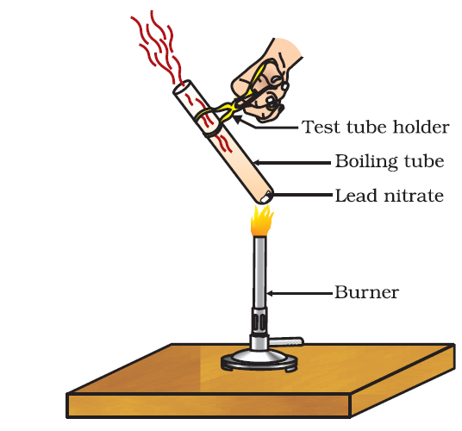
SOME MORE EXAMPLES OF DECOMPOSITION REACTION:
When a decomposition reaction is carried out by heating, it is called ‘thermal decomposition’.
Example: When lead nitrate is heated strongly, it breaks down to form simpler substances like lead monoxide, nitrogen oxide and oxygen.
2Pb(NO3)2(s)
heat
2PbO(s)
+
4NO2(g)
+
O2(g)
+
decomposition
Lead Nitrate Lead Monoxide Nitrogen Dioxide Oxygen
Notes:
Let us see how this reaction happens in the next video
We first take about 2 g lead nitrate powder in a boiling tube. We then heat it over a flame and see what are the reactions -

Slide 10
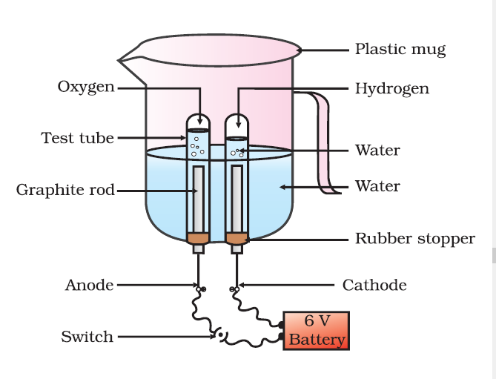

Some decomposition reactions are carried out by using electricity. Example: When electric current is passed through acidified water, it decomposes to give hydrogen gas and oxygen gas.
Notes:
In this example we see how decomposition can take place by using electricity -
Take a plastic mug. Drill two holes at its base and fit rubber stoppers in these holes. Insert carbon electrodes in these rubber stoppers. Connect these electrodes to a 6 volt battery. Fill the mug with water such that the electrodes are immersed. Add a few drops of dilute sulphuric acid to the water. Take two test tubes filled with water and invert them over the two carbon electrodes. Switch on the current and leave the apparatus undisturbed for some time. You will observe the formation of bubbles at both the electrodes. These bubbles displace water in the test tubes. Is the volume of the gas collected the same in both the test tubes? Once the test tubes are filled with the respective gases, remove them carefully. Test these gases one by one by bringing a burning candle close to the mouth of the test tubes.

Slide 11
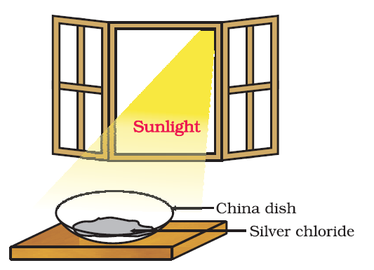
Some decomposition reactions are carried out by light energy. Example: When silver chloride is exposed to light, it decomposes to form silver metal and chlorine gas.
2AgCl(s)
light
2Ag(s)
+
Cl2(g)
+
decomposition
Silver Chloride Silver Chlorine
(White) (Grey)
Notes:
There is a another example showing decomposition using a light energy-
Take silver chloride in a china dish and note down its colour .Now put the china dish in sunlight for sometime , now observe the colour change-
The white silver chloride turns into grey where the chloride decomposes off the silver.

Slide 12
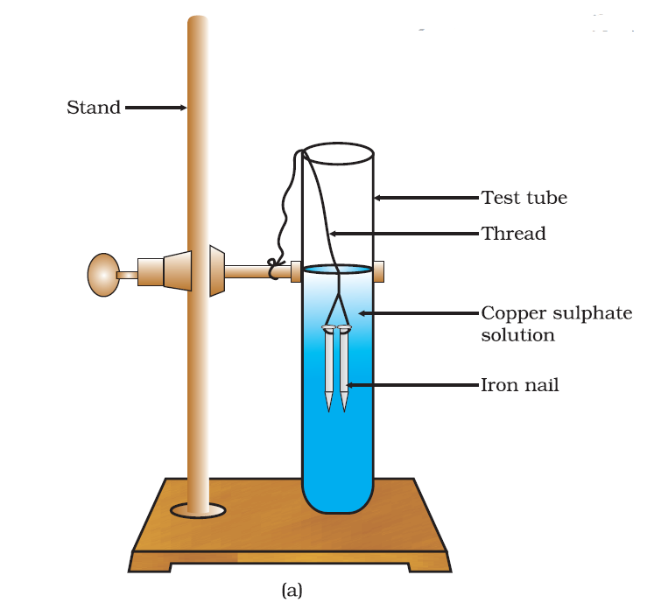
DISPLACEMENT REACTION
Those reactions, in which one element takes the place of another element in a compound, are known as displacement reactions.
Iron nails dipped in copper sulphate solution
Notes:
Next type of chemical reaction is displacement reaction-
Here one metal displaces another , this happens based on the priority order or metal with high order replaces metals with lower order.
Lets consider an example-
Take three iron nails and clean them by rubbing with sand paper. Take two test tubes marked as (A) and (B). In each test tube, take about 10 mL copper sulphate solution. Tie two iron nails with a thread and immerse them carefully in the copper sulphate solution in test tube B for about 20 minutes. Keep one iron nail aside for comparison . After 20 minutes, take out the iron nails from the copper sulphate solution. Compare the intensity of the blue colour of copper sulphate solutions in test tubes (A) and (B) . Also, compare the colour of the iron nail dipped in the copper sulphate solution with the one kept aside.

Slide 13
REACTIONS HAPPENING IN THE EXPERIMENT
The iron nail become brownish in colour and the blue colour of copper sulphate solution fades.
Fe(s)
+
CuSO4(aq)
Cu(s)
+
FeSO4(aq)
In this reaction, iron has displaced or removed another element, copper, from copper sulphate solution.
Notes:
We can see the iron nail become brownish in colour and the blue colour of copper sulphate solution fades. Here iron being higher order displaces the copper from copper sulphate solution.

Slide 14
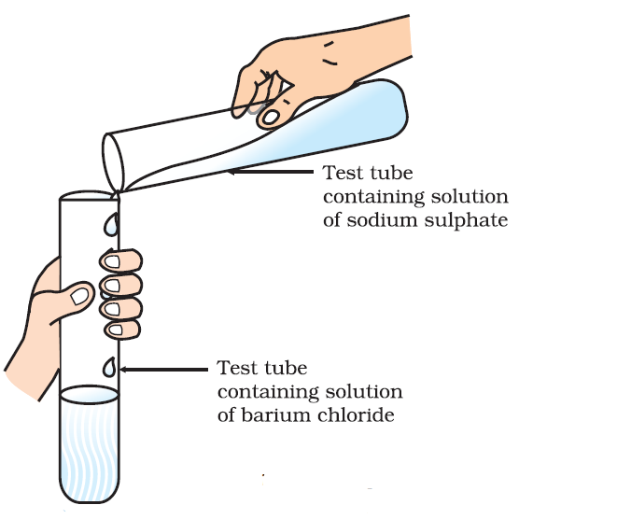
DOUBLE DISPLACEMENT REACTION
Those reactions, in which two compounds react by an exchange of ions to form two new compounds, are called double displacement reactions.
Formation of barium sulphate and sodium
chloride
Notes:
Steps to be followed:
1.Take about 3 ml of sodium sulphate solution in a test tube.
2.In another test tube, take about 3ml of barium chloride solution.
3.Mix the two solutions.
4.What do you observe?

Slide 15
REACTIONS HAPPENING IN THE EXPERIMENT:
We will observe that a white substance ,which is insoluble in water, is formed. This insoluble substance is known as a precipitate.
Any reaction that produces a precipitate can be called a precipitation reaction.
BaCl2(aq)
+
Na2SO4(aq)
BaSO4(s)
+
2NaCl
Barium Chloride Sodium Sulphate Barium Sulphate Sodium
(White ppt) Chloride
Notes:
If we see some kind of precipitate after a reaction gets completed we call such a reaction as precipitation reaction.

Slide 16
CONCLUSION
In this we study about the different types of reaction
Combination Reaction
Decomposition Reaction
Displacement Reaction
Double Displacement Reaction

